Slide 1
Markowitz Portfolio Optimization
Madhurima Dutta(M22MA056)
Mansi(M22MA057)
Vanshika Kumawat(M22MA207)
Nisha Shaw (M22MA059)
Group 3

Slide 2
What is Markowitz Portfolio Optimization?
- Markowitz portfolio optimization is a strategy for constructing investment portfolios.
- It aims to maximize returns while minimizing risk.
- Steps include selecting assets, estimating their returns and risks.
- Correlations between assets are analyzed.
- An efficient portfolio is constructed to balance risk and return.
- Diversification across assets with different risk-return profiles is key.

Slide 3
Historical Data
The data is taken from investing.com.Using their three months data from 1st oct 2023 to 31st Dec 2023.
https://docs.google.com/spreadsheets/d/1LIPiEVjliexOOMZtTHuEtLW-3m6zU0Y6nBsViBK949I/edit#gid=0.

Slide 4
Assets
The assets chosen are
Infosys Pvt Ltd.
Tata Motors
Sun Pharma
HDFC Bank
Reliance Industries
Bharti Airtel
Hindustan Unilever
Tata Steel
Bajaj Finance
NTPC

Slide 5
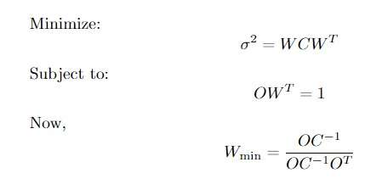
Markowitz Mean-Variance Optimization Formula
.

Slide 6
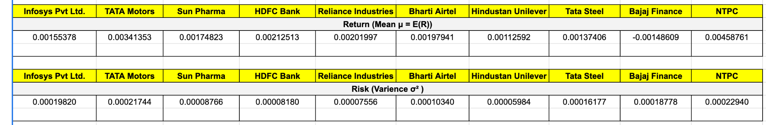
Risk and Return For Each Assets

Slide 7
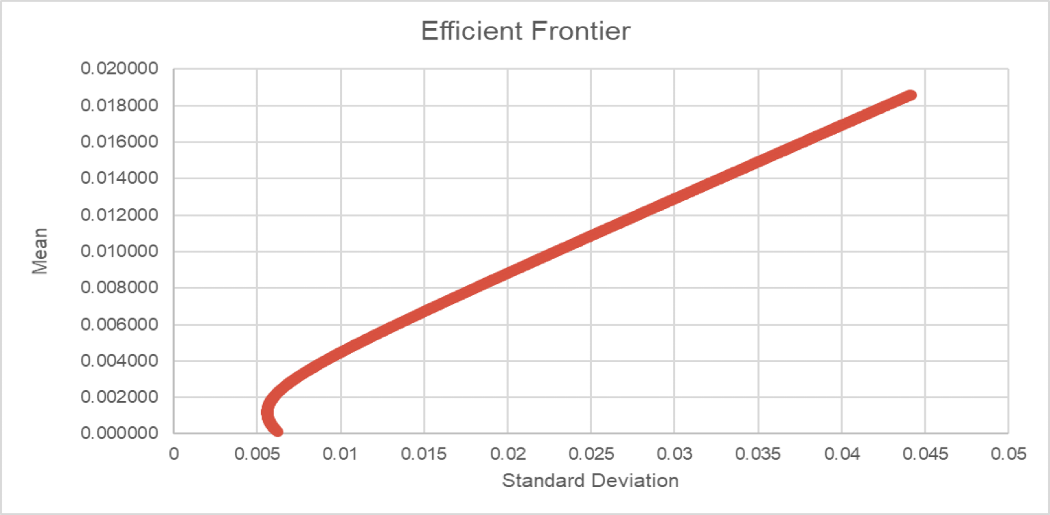
Efficient Frontier

Slide 8
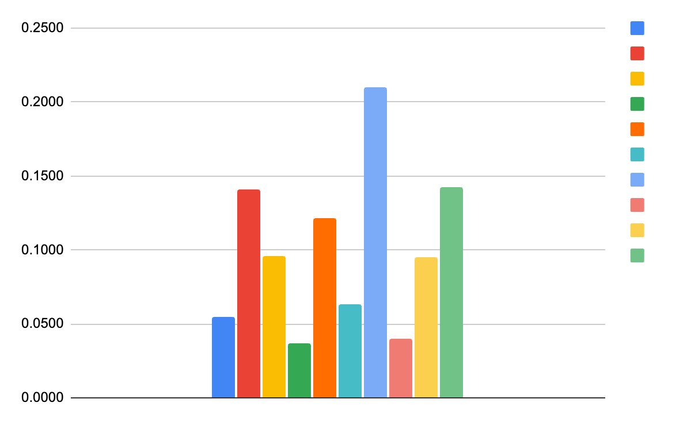
Weights For First Point
The Point chosen on efficient frontier is
(0.00016572618,0.00257127070).

Slide 9
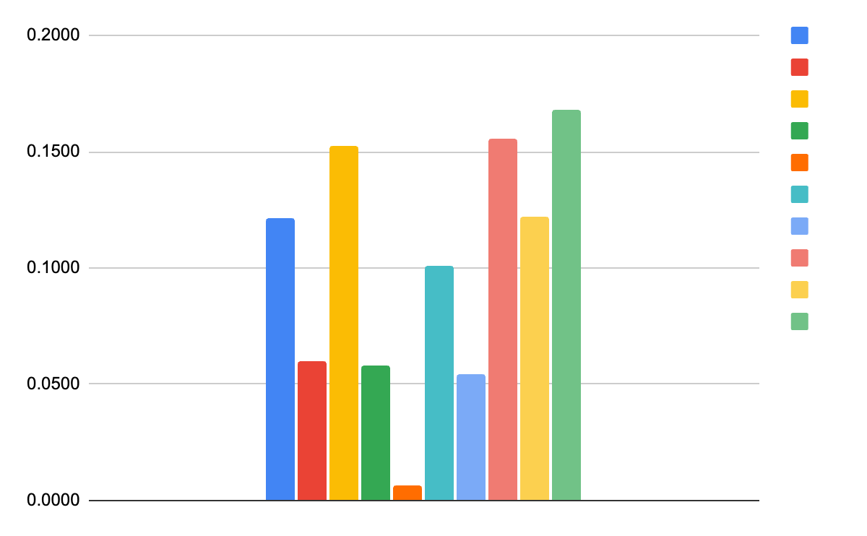
Weights For the Second Point
The Point chosen on efficient frontier is
(0.00013555352, 0.00226913898)

Slide 10
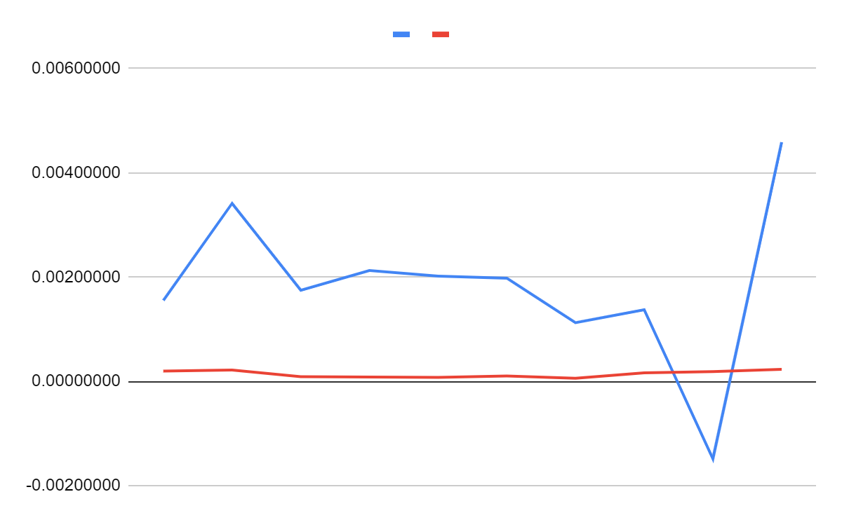
Trade-off: Risk Vs Return
jjsjs
jhjhshhsjjddjxhdhd
Return
Risk

Slide 11
Limitations of Markowitz Optimization
Markowitz optimization assumes that asset returns are normally distributed, which may not hold true in real-world scenarios.
The optimization is highly sensitive to input parameters such as expected returns, covariance matrix, and risk tolerance, which can lead to unstable and unreliable results.
Estimating expected returns and covariance matrix accurately is challenging, especially with limited historical data, leading to potential errors in portfolio construction.
Markowitz optimization may lead to highly concentrated portfolios, especially when dealing with a large number of assets, which can result in poor diversification and increased risk.

Slide 12
Application of Markowitz Portfolio
Portfolio Management: Maximizes returns for a given risk level.
Asset Allocation: Determines optimal asset mix based on historical returns and correlations.
Risk Management: Balances assets to reduce overall portfolio risk.
Wealth Management: Tailors investment strategies to individual risk tolerance and return objectives.
Mutual Funds: Constructs diversified portfolios for competitive returns.

Slide 13
Thank You

